Slide 1
Configuration Management

Slide 2




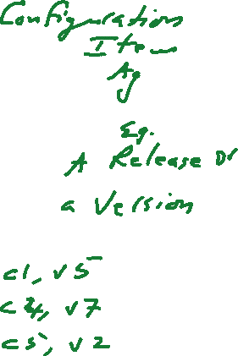








Slide 3














Slide 4















Slide 5


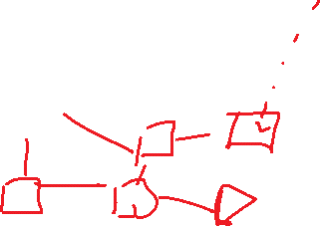



Slide 6
Configuration Management
Change pervades the development process.
  Requirements change when developers improve their understanding of the application domain.
  The system design changes with new technology and design goals.
  The object design changes with the identification of solution objects.
  The implementation changes as faults are discovered and repaired.
  These changes can affect every work product, from the system models to the source code and documentation.

Slide 7
Configuration Management
Configuration management is the process of controlling and monitoring change to work products.
Once a baseline is defined, configuration management minimizes the risks associated with changes by defining a formal approval and tracking process for changes.

Slide 8
Learning Objectives
Configuration item identification
  The modeling of the system as a set of evolving components
Promotion management
  The creation of versions for other developers
Release management
  The creation of versions for the client and users
Branch management
  The management of concurrent development
Variant management
  The management of versions intended to coexist
Change management
  The handling, approval and tracking of change requests

Slide 9
Overview
Configuration management is the discipline of managing and controlling change in the evolution of software systems [IEEE Std. 1024-1987].
Configuration management systems automate the identification of versions, their storage and retrieval, and supports status accounting.

Slide 10
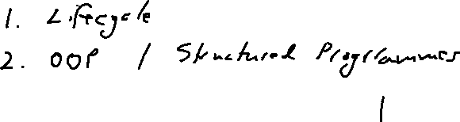
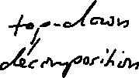






Slide 11

















Slide 12





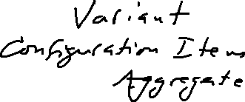







Slide 13










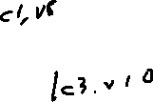



Slide 14
Overview
Configuration management includes the following activities:
  Identification of configuration items
  Change control
  Status accounting
  Auditing
The following are often considered part of configuration management:
  Build management
  Process management

Slide 15
Overview
Identification of configuration items
  Components of the system and its work products and their versions are identified and labeled uniquely.
  Developers identify configuration items once the principal deliverables and components of the system are agreed on.
  Developers create versions and additional configuration items as the system evolves.

Slide 16
Overview
Change control
  Changes to the system and releases to users are controlled to ensure consistency with project goals.
  Change control can be done by the developers, by management, or by a control board, depending on the level of quality required and the rate of change.

Slide 17
Overview
Status accounting
  The status of individual components, work products, and change requests are recorded.
  This allows developers to distinguish versions more easily and track issues related to changes.
  This also allows management to track project status.

Slide 18
Overview
Auditing
  Versions selected for release are validated to ensure the completeness , consistency, and quality of the product.
  Auditing is accomplished by the quality control team.

Slide 19
Overview
Build management
  Most configuration management systems enable the automatic building of the system as developers create new versions of the components.
  The configuration management system has sufficient knowledge of the system to minimize the amount of recompilation.
  It may also be able to combine different versions of components to build different variants of the system (e.g., for different operating system and hardware platforms).

Slide 20
Traditionally, configuration management is seen as a management discipline, helping project managers with change control, status accounting, and auditing activities.
More recently, however, configuration management has also been seen as a development support discipline, helping developers deal with the complexity associated with a large number of changes, components and variants.

Slide 21
Configuration Management Concepts
Terminology from IEEE Std. 1042-1987
Configuration Item
  A work product or a piece of software that is treated as a single entity for the purpose of configuration management.
  A composite of configuration items is defined as a configuration management aggregate (CM aggregate)
Change Request
  A formal report issued by a user or a developer to request a change in a configuration item.

Slide 22
Configuration Management Concepts
Version
  Identifies the state of a configuration item or a configuration item at a well defined point in time.
  Given a CM aggregate , a consistent set of versions of its configuration items is defined as a configuration.
  I.e., a configuration can be thought of as a version of a CM aggregate.
Versions that are intended to coexist are called variants

Slide 23
Configuration Management Concepts
Promotion
  A version that has been made available to other developers in the project.
Release
  A version that has been made available to the client or the users.
Software Library
  Stores versions and provides facilities to track the status of changes.
  A repository is a library of releases.
  A master directory is a library or promotions

Slide 24
Configuration Items and CM Aggregates
Configuration Item
  A work product or a component of a work product that is under configuration management and treated as a single entity for such purposes. For example, the device driver for a serial port in any operating system is a configuration item. This components is simple enough that it cannot be further broken down for installation.

Slide 25
Configuration Items and CM Aggregates
CM Aggregate
  A composition of configuration items.
  E.g. , the Linux operating system is a CM aggregate that includes a process scheduler, a memory manager, many device drivers, network daemons, file systems and many other subsystems.

Slide 26
Versions and Configurations
Version
  Identifies the state of a configuration item at a well-defined point in time.
  Successive versions of a work product differ by one or more changes, such as the correction of a fault, the addition of new functionality, or the removal or unnecessary or obsolete functionality.
  A configuration identifies the state of a CM aggregate.

Slide 27
Versions and Configurations
Baseline
  A version of a configuration item that has been formally reviewed and agreed on by management or the client, and which can be changed only through a change request.
  This ensures that changes are made consistently with project goals (e.g., safety and reliability) and regulations, and that they are communicated to relevant developers and users.
Variants
  Versions that are intended to coexist are called variants. E.g., a software system can have a Macintosh variant, a Windows variant and a Linux variant, each providing identical functionality. A system may also have a standard variant, and a professional or deluxe variant, supporting a different range of functionality.
  Variants share a large amount of code that implements core functionality, and differences are confined to a small number of lower level subsystems.

Slide 28
Change Requests
A formal step in initiating the change process.
A user, client, or developer discovers a fault in a work product or wants a new feature.
The author of the change request specifies the configuration item to which the request applies, its version, the problem to be solved, and a proposed solution.
In the case of a formal change process, the costs and benefits of the change are then assessed before the change is approved or rejected. In both cases the rationale of the decision is recorded with the change request.

Slide 29
Promotions and Releases
Promotion
  A promotion is a version that is made available to other developers.
  A promotion denotes (indicates) that a configuration item has reached a relatively stable state and can be used or reviewed by other developers. E.g., subsystems are promoted for other teams using that subsystem. Subsystems are then promoted for the quality control team to assess their quality. Later, as faults are discovered and repaired, revisions of the subsystem are promoted for reevaluation.

Slide 30
Promotions and Releases
Release
  A version that is made available to users. A release denotes that a configuration item has met the quality criteria set by the quality control team and can be used or reviewed by the users.
  E.g., a system is released to beta testers so that they might find additional faults and assess the perceived quality of the system.
  As faults are discovered and repaired, revisions of the subsystem are promoted for reevaluation by the quality control team and, when the quality criteria are met, released again to the users.

Slide 31
Repositories and Workspaces
Configuration management systems provide a repository in which all configuration items are stored and tracked and a workspace in which the developer makes changes. Developers create new versions by checking in changes from their workspace to the repository.
A software library, as defined in [IEEE Std. 1042-1987], provides facilities to store, label, and identify versions of the configuration items (i.e., documentation, models, and code). A software library also provides functionality to track the status of changes to the configuration items.

Slide 32
Repositories and Workspaces
Workspace
  The developer’s workspace, also known as dynamic library, is used for everyday development by the developers. Change is not restricted and is controlled by the individual developer only.
Master Directory
  Also known as the controlled library, tracks promotions. Change needs to be approved and versions need to meet certain project criteria (e.g., only code that can be compiled without errors may be checked in) before they can be made available to the rest of the project.
Repository
  Also known as the static library, tracks releases. Promotions need to meet certain quality control criteria (e.g., all faults detected by regression tests must be repaired) before a promotion becomes a release.

Slide 33
Version Identification Schemes
Versions are uniquely identified by developers and systems using a version identifier, also called a version number. Some exotic examples include:
  The Ada specification went through five successive major versions, named Strawman, Woodenman, Tinman, Ironman and Steelman.
  The version identification scheme for TeX, a typesetting system for technical texts, is based on decimals of the number π: Each time a bug is found (which is rare) and repaired, the version number of TeX is incremented to add another digit. The current version is 3.1415926.
  In general, however, version numbers of a given configuration item can be quite large. In this case, developers and configuration management systems use version identification schemes that support automation more easily, such as sequential numbers with two or three decimals, Here is a three digit version identification scheme in Backus-Naur Form:
    <version> ::= <Configuration item name>.<major>.<minor>.<revision>
    <major>::=<nonnegative integer>
    <minor>::=<nonnegative integer>
    <revision>::=<nonnegative integer>

Slide 34
Development can take place in multiple threads, i.e., branches. It is very often the case that developers work on multiple improvements concurrently.
This implies that everyone works with the most recent version of a component they depend upon, or older stable versions of components they depend upon. This approach works fine if changes affect non-overlapping sets or components and interfaces remain backward compatible. However, when two change require modifications to the same component, a different approach is required. Concurrent branches and subsequent merging can be used to coordinate changes.
Merging, is a nontrivial operation.

Slide 35
Documenting Configuration Management
[IEEE Std. 828-1990] is a standard for writing Software Configuration Management Plans (SCMP).
Such a plan documents all the relevant information to the configuration management activities of a specific project. The plan is generated during the planning phase, put under configuration management, and revised as necessary. The scope and length of the plan may vary according to the needs of the project.

Slide 36
Template
Introduction
  Purpose
  Scope
  Key terms
  References
Management
  Organization
  Responsibilities
Activities
Schedule
Resources
Plan maintenance

Slide 37
SCMP
Contains six types of information:
Introduction
  Describes the scope and audience of the document, key terms, and references
Management
  Describes the organization of the project (which can be a reference to the corresponding section of the Software Project Management Plan) and how the configuration management responsibilities are assigned within then organization
Activities
  Describes in detail the identification of configuration items, the change control process, the process for creating releases and for auditing, and the process for status accounting. Responsibilities for each of these activities are assigned to a role defined in the management section.
Schedule
  Denotes when the configuration activities take place and how they are coordinated. In particular it defines at which point changes can be requested and approved through the formal change process.
Resources
  Identifies the tools, techniques, equipment, personnel, and training necessary for accomplishing the configuration activities.
Plain maintenance
  Defines how the SCMP, itself under configuration management, is maintained and revised. In particular, this section deals with the person responsible for its maintenance, the frequency of updates, and the change process for updating the plan.

